Slide 1
Digital Image Processing Image Segmentation

Slide 2
Image Segmentation
Image segmentation divides an image into regions that are connected and have some similarity within the region and some difference between adjacent regions.
The goal is usually to find individual objects in an image.
For the most part there are fundamentally two kinds of approaches to segmentation: discontinuity and similarity.
Similarity may be due to pixel intensity, color or texture.
Differences are sudden changes (discontinuities) in any of these, but especially sudden changes in intensity along a boundary line, which is called an edge.

Slide 3
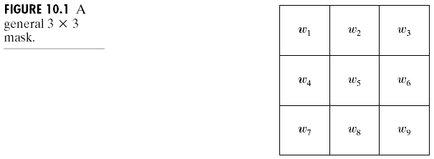
Detection of Discontinuities
There are three kinds of discontinuities of intensity: points, lines and edges.
The most common way to look for discontinuities is to scan a small mask over the image. The mask determines which kind of discontinuity to look for.

Slide 4
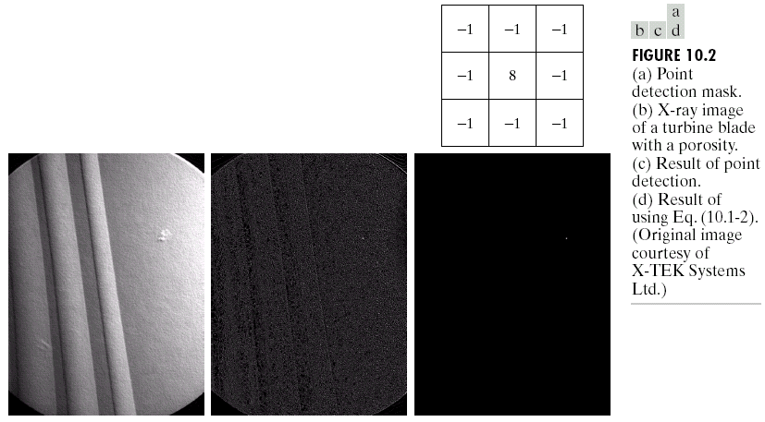
Detection of Discontinuities
Point Detection

Slide 5
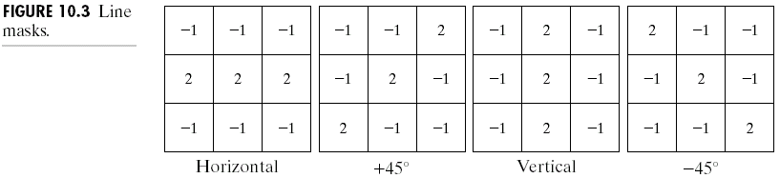
Detection of Discontinuities
Line Detection
Only slightly more common than point detection is to find a one pixel wide line in an image.
For digital images the only three point straight lines are only horizontal, vertical, or diagonal (+ or –45°).

Slide 6
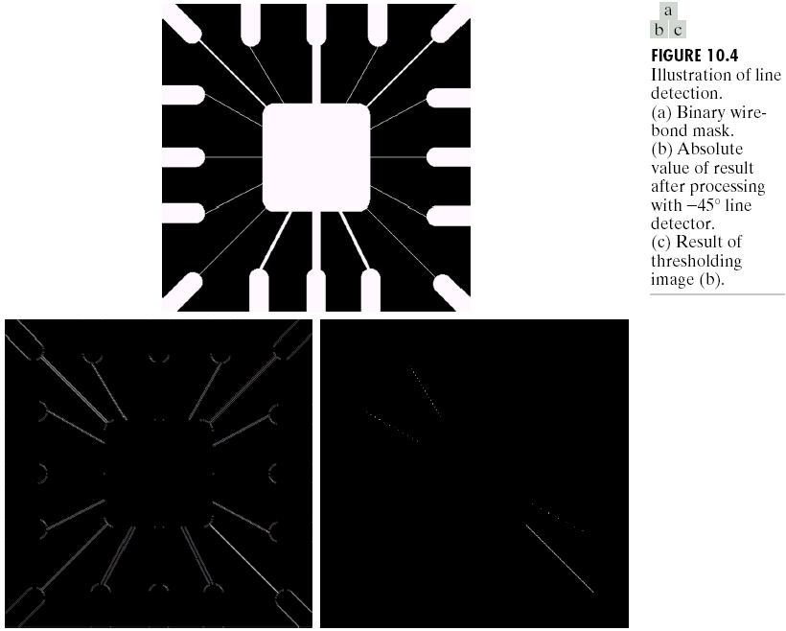
Detection of Discontinuities
Line Detection

Slide 7
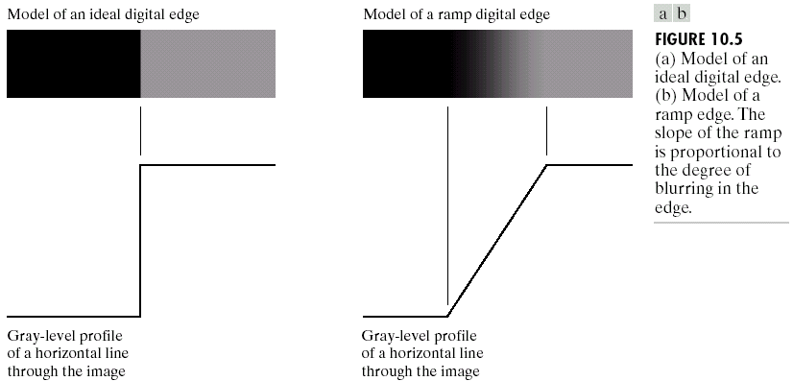
Detection of Discontinuities
Edge Detection

Slide 8
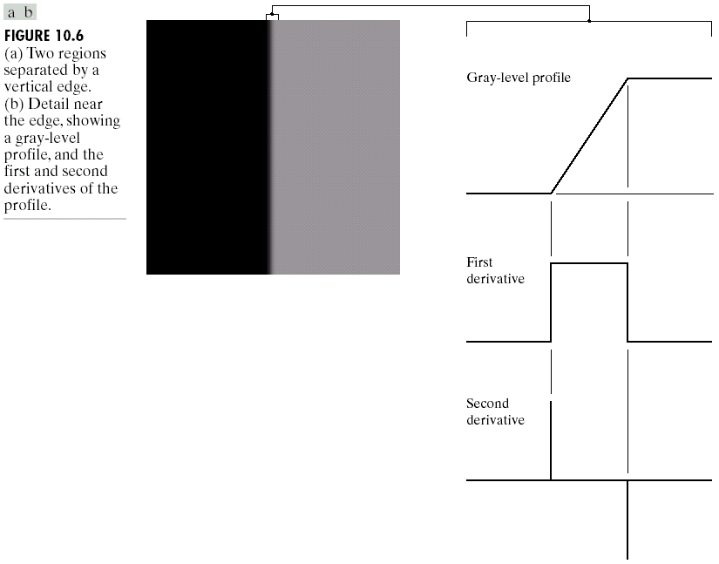
Detection of Discontinuities
Edge Detection

Slide 9
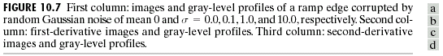
Detection of Discontinuities
Edge Detection

Slide 10
Detection of Discontinuities
Edge Detection

Slide 11
Detection of Discontinuities
Gradient Operators
First-order derivatives:
The gradient of an image f(x,y) at location (x,y) is defined as the vector:
The magnitude of this vector:
The direction of this vector:

Slide 12
Detection of Discontinuities
Gradient Operators
Roberts cross-gradient operators
Prewitt operators
Sobel operators

Slide 13
Detection of Discontinuities
Gradient Operators
Prewitt masks for
detecting diagonal edges
Sobel masks for
detecting diagonal edges

Slide 14
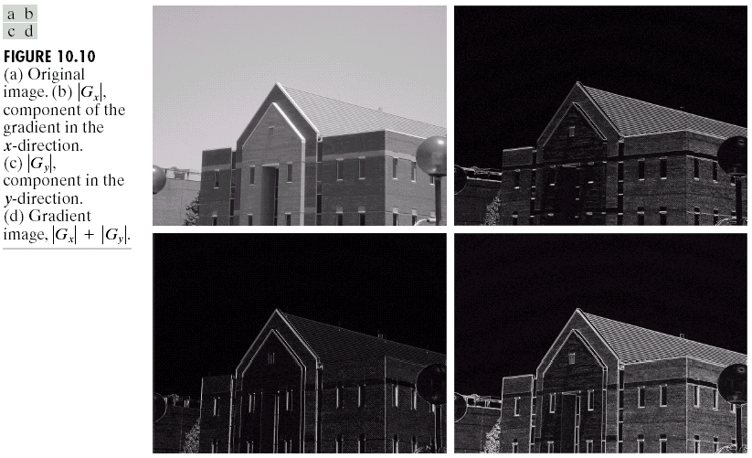
Detection of Discontinuities
Gradient Operators: Example

Slide 15
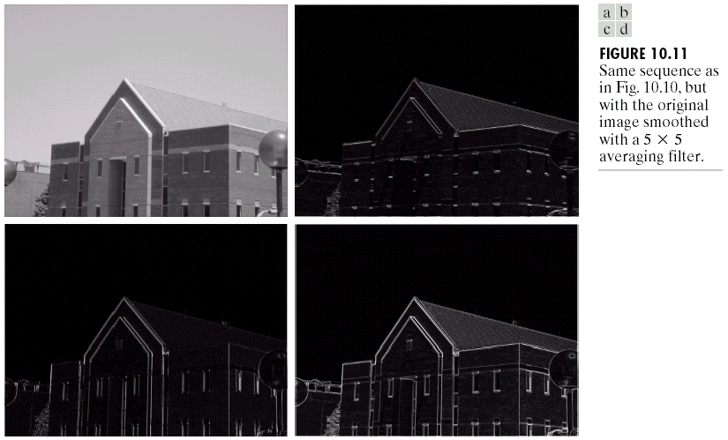
Detection of Discontinuities
Gradient Operators: Example

Slide 16
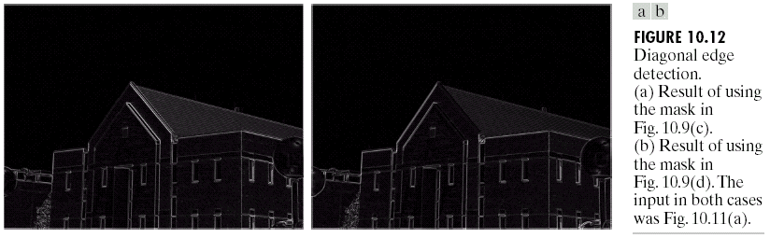
Detection of Discontinuities
Gradient Operators: Example

Slide 17
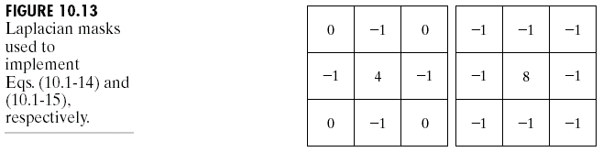
Detection of Discontinuities
Gradient Operators
Second-order derivatives: (The Laplacian)
The Laplacian of an 2D function f(x,y) is defined as
Two forms in practice:

Slide 18
Detection of Discontinuities
Gradient Operators
Consider the function:
The Laplacian of h is
The Laplacian of a Gaussian sometimes is called the Mexican hat function. It also can be computed by smoothing the image with the Gaussian smoothing mask, followed by application of the Laplacian mask.
A Gaussian function
The Laplacian of a Gaussian (LoG)

Slide 19
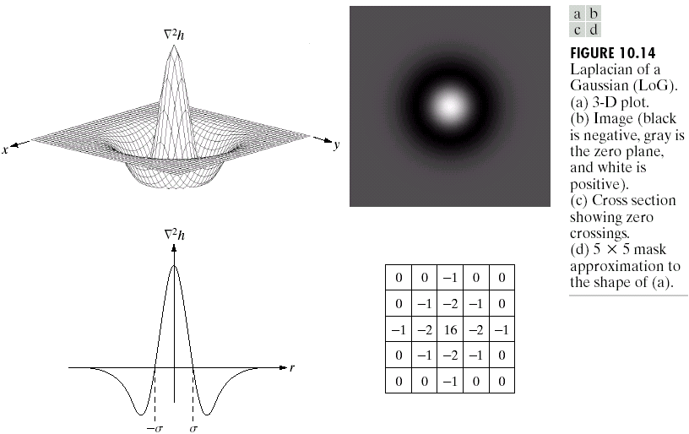
Detection of Discontinuities
Gradient Operators

Slide 20
Detection of Discontinuities
Gradient Operators: Example
Sobel gradient
Gaussian smooth function
Laplacian mask

Slide 21
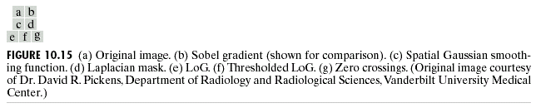
Detection of Discontinuities
Gradient Operators: Example-Continued

Slide 22
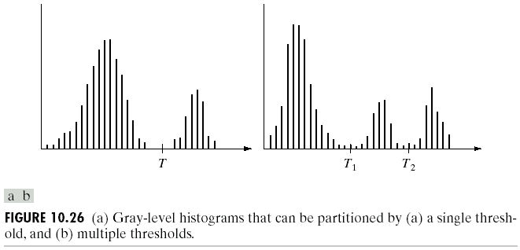
Thresholding
Assumption: the range of intensity levels covered by objects of interest is different from the background.
Single threshold
Multiple threshold

Slide 23
Thresholding
The Role of Illumination

Slide 24
Thresholding
The Role of Illumination
(a)
(c)
(d)
(e)

Slide 25
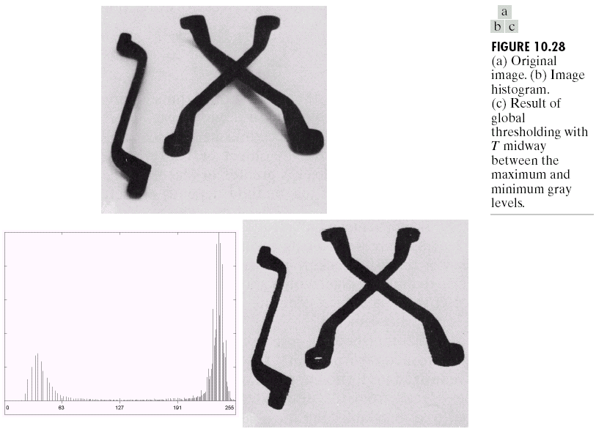
Thresholding
Basic Global Thresholding

Slide 26
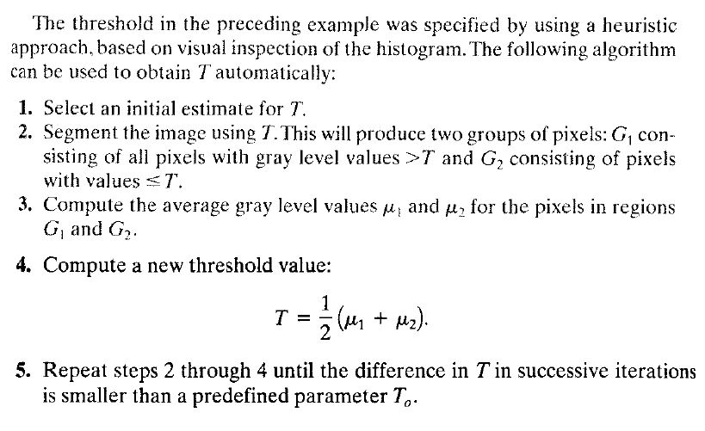

Slide 27
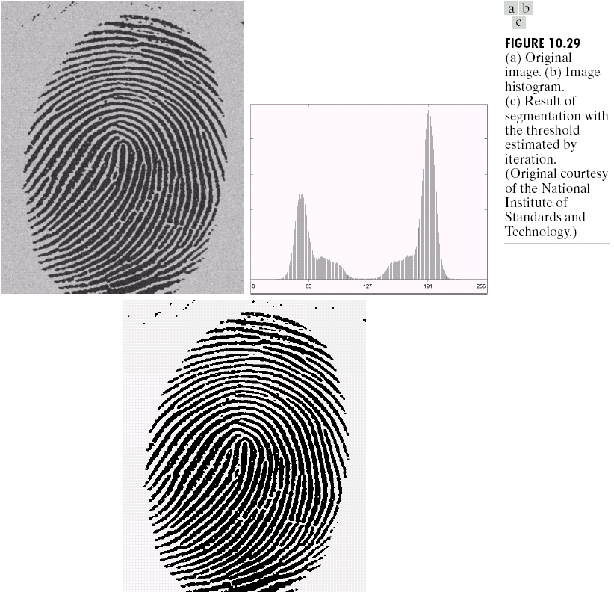
Thresholding
Basic Global Thresholding

Slide 28
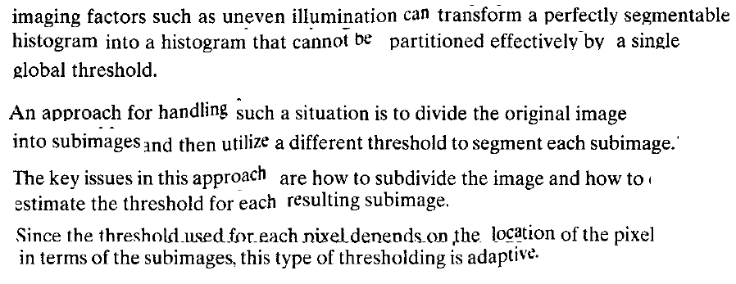
Thresholding
Basic Adaptive Thresholding

Slide 29
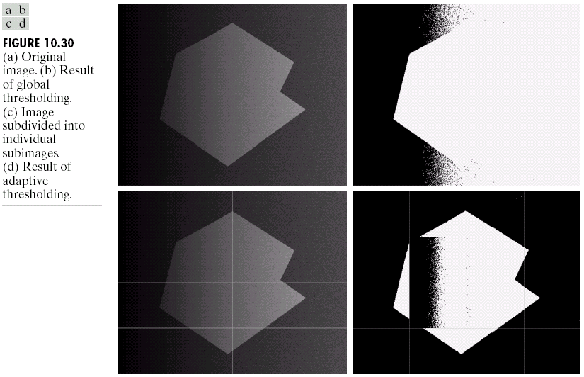
Thresholding
Basic Adaptive Thresholding

Slide 30
Thresholding
Basic Adaptive Thresholding
How to solve this problem?

Slide 31
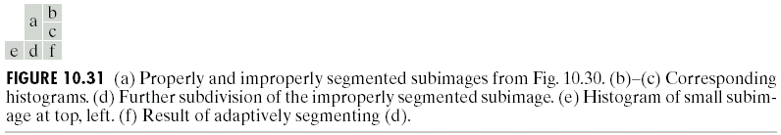
Thresholding
Basic Adaptive Thresholding
Answer: subdivision

Slide 32
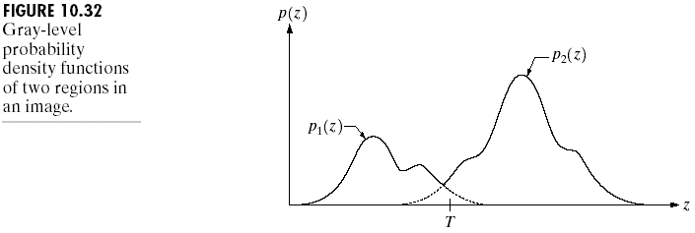
Thresholding
Optimal Global and Adaptive Thresholding
This method treats pixel values as probability density functions.
The goal of this method is to minimize the probability of misclassifying pixels as either object or background.
There are two kinds of error:
mislabeling an object pixel as background, and
mislabeling a background pixel as object.

Slide 33
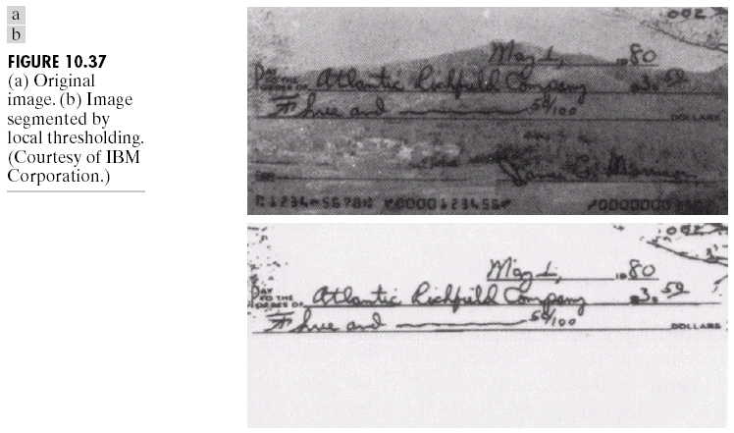
Thresholding
Use of Boundary Characteristics

Slide 34
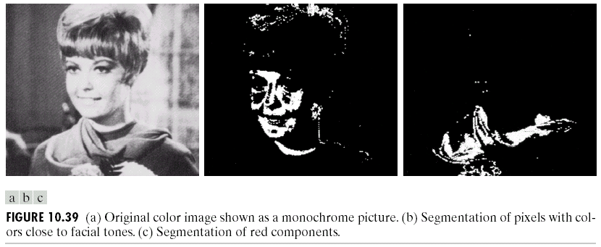
Thresholding
Thresholds Based on Several Variables
Color image

Slide 35
Region-Based Segmentation
Edges and thresholds sometimes do not give good results for segmentation.
Region-based segmentation is based on the connectivity of similar pixels in a region.
Each region must be uniform.
Connectivity of the pixels within the region is very important.
There are two main approaches to region-based segmentation: region growing and region splitting.

Slide 36
Region-Based Segmentation
Basic Formulation
Let R represent the entire image region.
Segmentation is a process that partitions R into subregions, R₁,R₂,…,R_{n}, such that
where P(R_{k}): a logical predicate defined over the points in set R_{k}
For example: P(R_{k})=TRUE if all pixels in R_{k} have the same gray level.

Slide 37
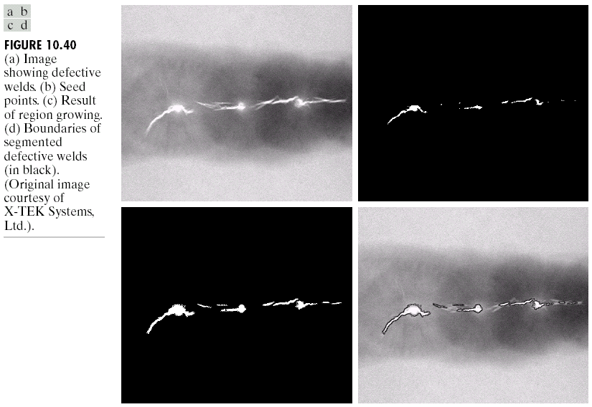
Region-Based Segmentation
Region Growing

Slide 38
Region-Based Segmentation
Region Growing
Fig. 10.41 shows the histogram of Fig. 10.40 (a). It is difficult to segment the defects by thresholding methods. (Applying region growing methods are better in this case.)
Figure 10.40(a)
Figure 10.41

Slide 39
Region-Based Segmentation
Region Splitting and Merging
Region splitting is the opposite of region growing.
First there is a large region (possible the entire image).
Then a predicate (measurement) is used to determine if the region is uniform.
If not, then the method requires that the region be split into two regions.
Then each of these two regions is independently tested by the predicate (measurement).
This procedure continues until all resulting regions are uniform.

Slide 40
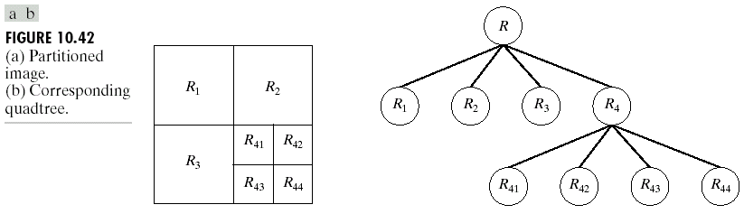
Region-Based Segmentation
Region Splitting
The main problem with region splitting is determining where to split a region.
One method to divide a region is to use a quadtree structure.
Quadtree: a tree in which nodes have exactly four descendants.

Slide 41
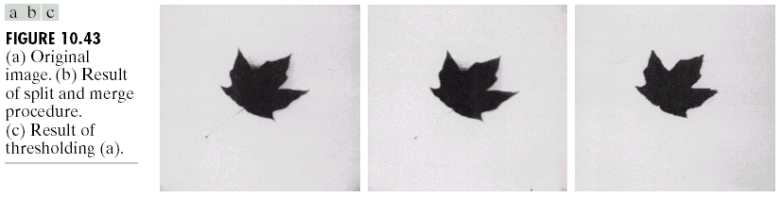
Region-Based Segmentation
Region Splitting and Merging
The split and merge procedure:
Split into four disjoint quadrants any region R_{i} for which P(R_{i}) = FALSE.
Merge any adjacent regions R_{j} and R_{k} for which P(R_{j}UR_{k}) = TRUE. (the quadtree structure may not be preserved)
Stop when no further merging or splitting is possible.

